Slide 1
No cost Fundraising

Slide 2
No Cost Fundraisers at St. Peter’s
Box Tops for Education
Campbell’s Soup Labels for Education
Capri Sun Drink Pouches
Soda can pop tops
Link your store Cards

Slide 3
Box Tops for Education
St. Peter’s Catholic School, Greenville NC
$3,008
Playground equipment
4,000
More for our playground!!!

Slide 4
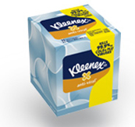
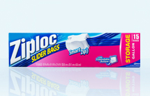
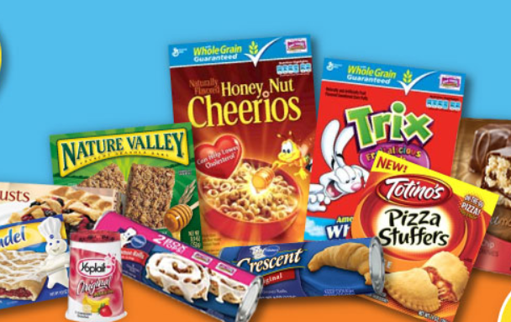
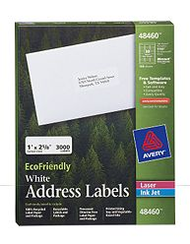
Box Tops For Education
Some participating products…

Slide 5
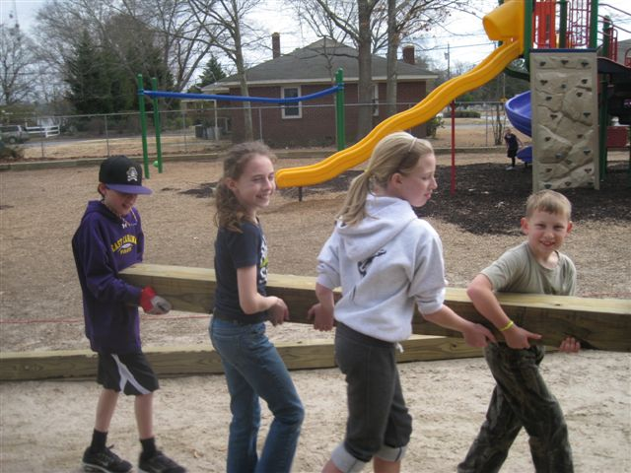
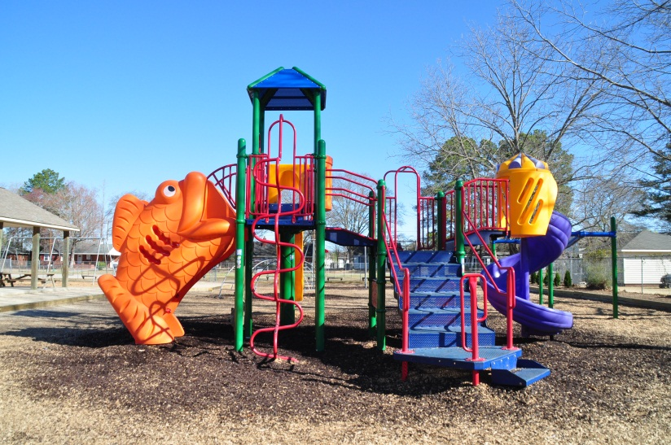
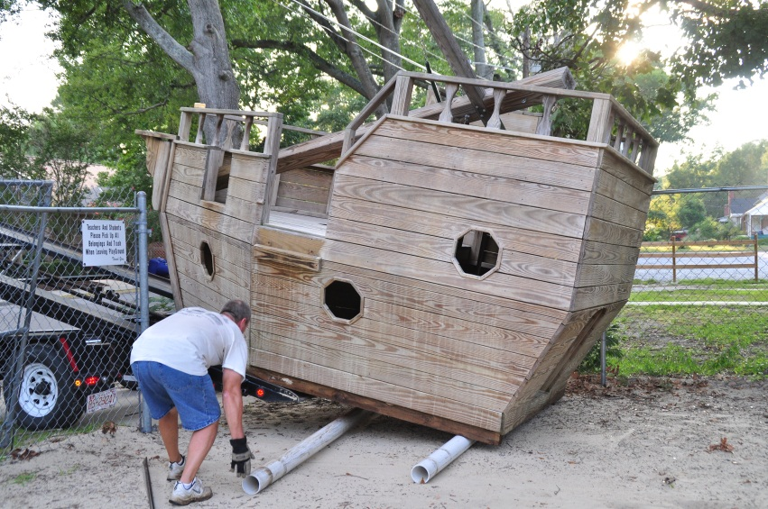
Just clip those box tops and send them in with your child! Each one helps out our playground

Slide 6
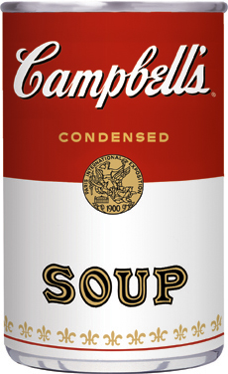
Campbell’s Soup labels for Education
Earn points for
St. Peter’s!

Slide 7
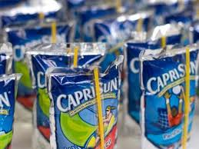
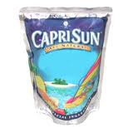
Capri Sun Drinks
Each pouch brings the school $.02!

Slide 8
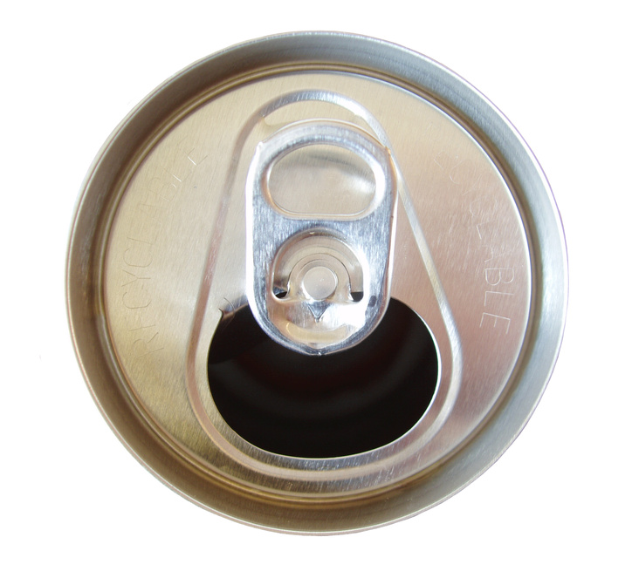
Bring in your Pop Tops to help someone with dialysis treatment

Slide 9
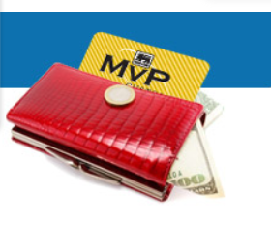
Store Cards
Target Visa Cards
Food Lion MVP
Harris Teeter VIC card
Be sure to link your card each school year!

